Slide 1
Defining Your Family’s Philanthropic Purpose
Navigating Family Philanthropy Series Webinar
June 14, 2022
Notes:
Border box and logo need to be added separately to slide (not in layout)
Slide 1 shows the layout without content

Slide 2
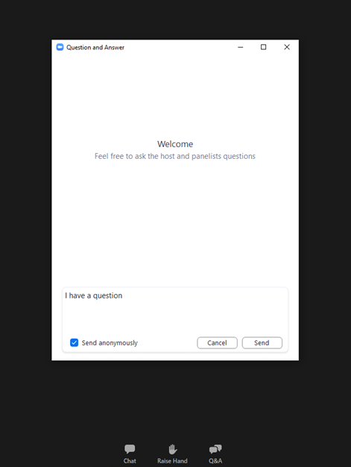
Submit Your Questions
Submit your questions into the Q&A box on your control panel at the bottom of the screen or use the chat.
Closed Captioning
Click “Live Transcript” on your Zoom control panel to see subtitles.

Slide 3
Schwab Charitable’s mission is to increase giving in the U.S. with donor advised funds and philanthropic services that make charitable giving tax-smart, simple and efficient.
We offer tools, guidance and relationships that empower donors to incorporate charitable planning into their everyday lives and make a bigger difference in the world. Visit https://www.schwabcharitable.org/ for more information.

Slide 4
NCFP is a network of philanthropic families committed to a world that is vibrant, equitable, and resilient. We share proven practices, work through common challenges, and learn together to strengthen our ability to effect meaningful change.
Our range of programs and services support family philanthropy at its many points of inflection and help families embrace proven practices and advance momentum.
For additional information about joining NCFP, please email ncfp@ncfp.org or visit https://www.ncfp.org/join/.

Slide 5
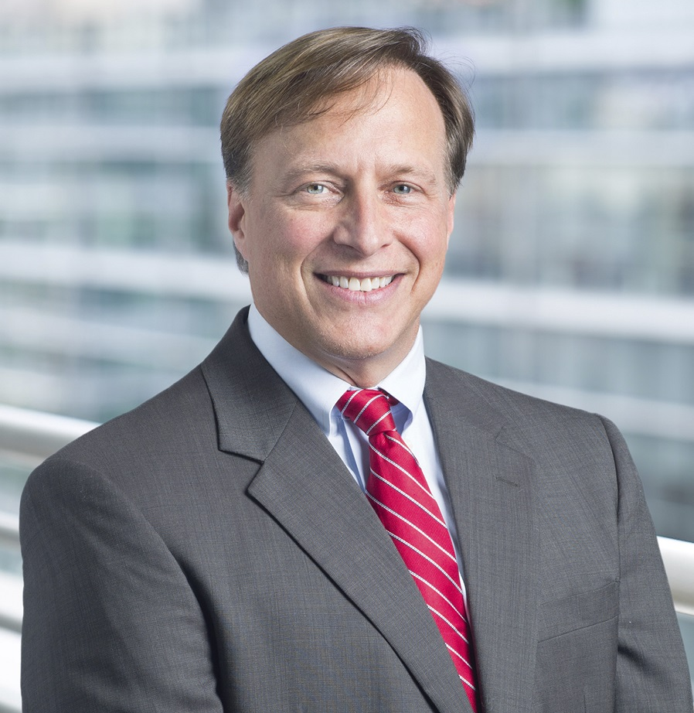
Fred Kaynor
Tony Macklin, CAP®
Vice President, Business Development, Marketing & Strategic Partnerships
Schwab Charitable
Philanthropic Advisor
Senior Program Consultant, NCFP

Slide 6
Jean Buckley
Megan Costigan
President
Tracy Family Foundation
Third Generation member and Program Manager
Tracy Family Foundation

Slide 7
Overview

Slide 8
Navigating Family Philanthropy Series (2022)
Defining Your Philanthropic Purpose
Choosing Your Philanthropic Vehicles
Choosing Your Social Impact Strategies
Strengthening Governance and Family Dynamics
Planning for Legacy and Succession
Notes:
5 topics

Slide 9
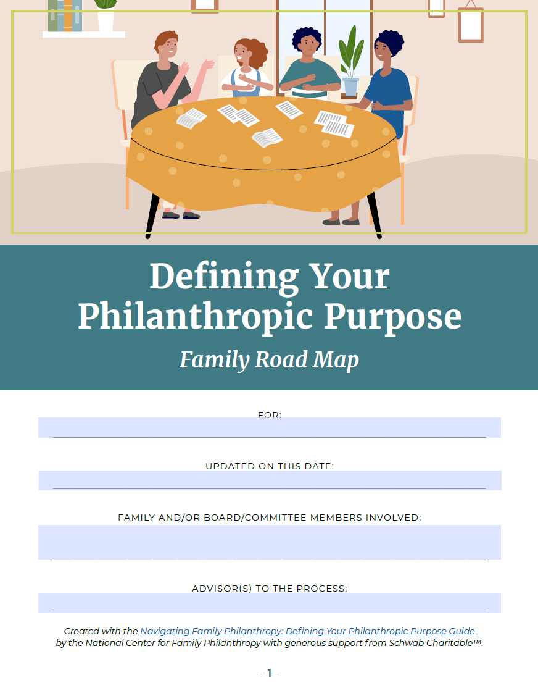
Each Topic Has…
Guide
For individuals and couples
Road Map
For families
4-5 Minute
Intro Video
For families

Slide 10
Definitions
Philanthropy is voluntary action for the public good.
It includes giving, granting, volunteering, investing for social or environmental impact, building social enterprises, advocacy, and/or other actions that intentionally benefit others.
Also called “social impact.”
Family philanthropy is when a group of family members (self-defined) takes those actions together.
Could include biological family, adopted family, family of choice, even friends or coworkers…

Slide 11
Philanthropic Purpose asserts Your Why
Benefits:
Guide group decision-making
Bring heart and soul to use of philanthropic resources
Clearer donor intent after you’re gone
Notes:
Each individual in the family should determine purpose
Each couple or nuclear family should do so
And then purpose for the philanthropic vehicle, collaborative action
Purpose is some combination of the following elements…

Slide 12
1. Motivations
The underlying reasons driving and inspiring your philanthropy.
Ex) personal experiences, faith, mentors, compelling needs

Slide 13
2. Values & Principles
The moral compass that shapes our character and decisions.
Ex) authenticity, diversity, freedom, joy, service

Slide 14
3. Priorities
Preferences for:
Populations
Places
Issues
Ideals or institutions

Slide 15
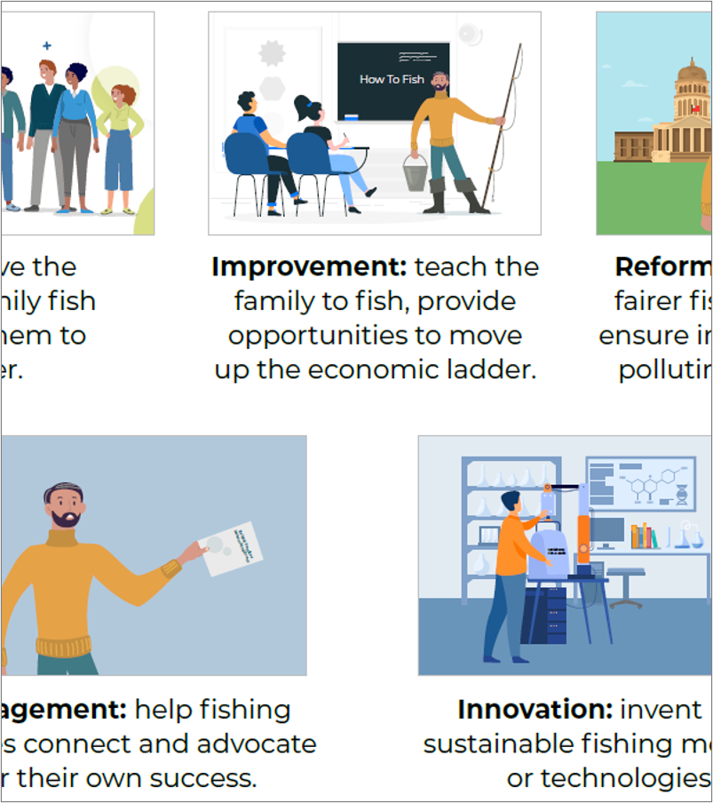
4. Giving Style
Preferred approach to problem-solving.
Ex) relief, reform, innovation
Initial operational choices.
Ex) timeframe, level of collaboration, publicity

Slide 16
5. Bring it together
Purpose or mission statement – how you’ll work toward a better world
Optional:
Vision
Credo
Legacy statement

Slide 17
Personal Perspectives

Slide 18
Tracy Family Foundation
Generation | #s
1Gs (deceased) | 2
2Gs | 24
3Gs | 66
4Gs | 42
TOTAL | 134
June 14, 2022
Schwab Charitable & NCFP Webinar

Slide 19
Tracy Family Foundation SHARED PRIORITIES & GIVING STYLE
Next Generation Grant Program
Allowance per Eligible Participant|
5 - 10 years old: $1,000
11 - 17 years old: $2,000
18 - 24 years old: $3,000
25 - 30 years old: $5,000
Site Visit Requirement|
Ages 5 – 17: site visit is required
Ages 18 – 30: site visit or phone interview
Matching Grant Program
Allowance per Eligible Participant|
$60,000/year
Match Ratio Options|
1:1 to 5:1 (depends on age of participant)

Slide 20
Tips for Families
Be more inclusive than less
Take multiple conversations that allow for storytelling, mutual learning, external resources
Focus your vehicle on areas of the most shared interest, push the rest to individual philanthropy
Treat the results as a living draft

Slide 21
Tips for Advisors
60-minute Zoom or in-person with a client family – help them kick off a discussion
90-minute client event – intro a topic, take group through 1-2 exercises
Day-long retreat to draft a shared plan or road map (will require homework before and after)
A set of quarterly family conversations to create a shared plan or road map

Slide 22
What’s Next?

Slide 23
Stay Tuned…
Expanding set of resources at
www.schwabcharitable.org/family-philanthropy
Emails from Schwab with a link to today’s recording and with dates of upcoming webinars on:
Choosing philanthropic vehicles
Developing a social impact strategy
Strengthening Governance and Family Dynamics
Planning for Legacy and Succession

Slide 24
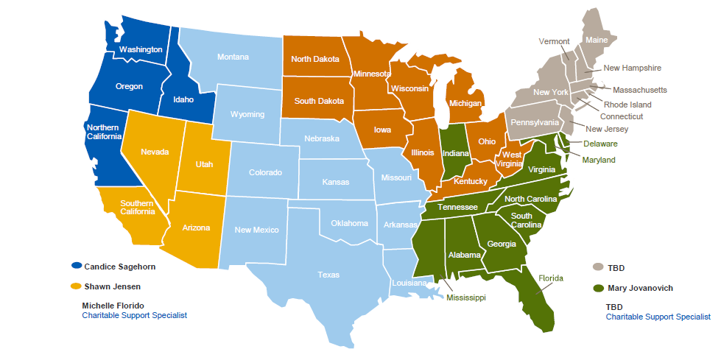
Need help?
Candice Sagehorn 415-667-6340 Juli Bartlett 310-407-0736 Michelle Florido Charitable Support 415-667-6203 | Brian Howell, CFP®, MS 720-418-2381 Chris Boyce 224-477-6690 Chris Altimont Charitable Support 720-202-2933 | Cori Oliver 617-960-5226 Mary Jovanovich, CAP® 317-596-6720 Corey Harman Charitable Support 720-418-4138
Schwab Charitable Consultants
24

Slide 25
Defining Your Family’s Philanthropic Purpose
www.schwabcharitable.org/family-philanthropy
www.ncfp.org

